Slide 1





APA Formatting and Style Guide

Slide 2

What is APA Style?
The American Psychological Association (APA) citation style is the most commonly used format for manuscripts in the social sciences.
APA regulates:
Stylistics
In-text citations
References
APA Formatting and Style Guide

Slide 3
Point of View &Voice
Personal pronouns where appropriate
✓: “We conducted an experiment…”
✗: “The authors conducted an experiment….”
Active voice rather than passive voice
✓: “We asked participants questions.”
✗: “The participants have been asked questions by the researchers.”
APA Formatting and Style Guide

Slide 4
Language
Language in an APA paper should be:
Clear: be specific in descriptions and explanations
Concise: condense information when you can
Plain: use simple, descriptive adjectives and minimize figurative language
APA Formatting and Style Guide

Slide 5
Types of APA Papers
The Literature Review:
Summarizes scientific literature on a particular research topic
Includes:
a title page,
introduction, and
a list of references
APA Formatting and Style Guide

Slide 6
Types of APA Papers
The Experimental Report:
Describes your experimental research
Includes:
a title page,
abstract,
introduction,
methods, results, and discussion sections,
a list of references,
appendices,
tables, and
figures
APA Formatting and Style Guide

Slide 7
Types of APA Papers
If your paper fits neither category:
Follow the general format
Consult the instructor
Consult the APA Publication Manual
APA Formatting and Style Guide

Slide 8
General APA Format
Your essay should:
be typed,
double-spaced,
have 1” margins,
use 10-12pt. Standard font (ex. Times New Roman), and
be printed on standard-sized paper (8.5”x 11”)
[Note: If you are writing a manuscript draft, APA suggests using two spaces between sentences to aid readability (see pp.87-88 in the APA manual).
APA Formatting and Style Guide

Slide 9
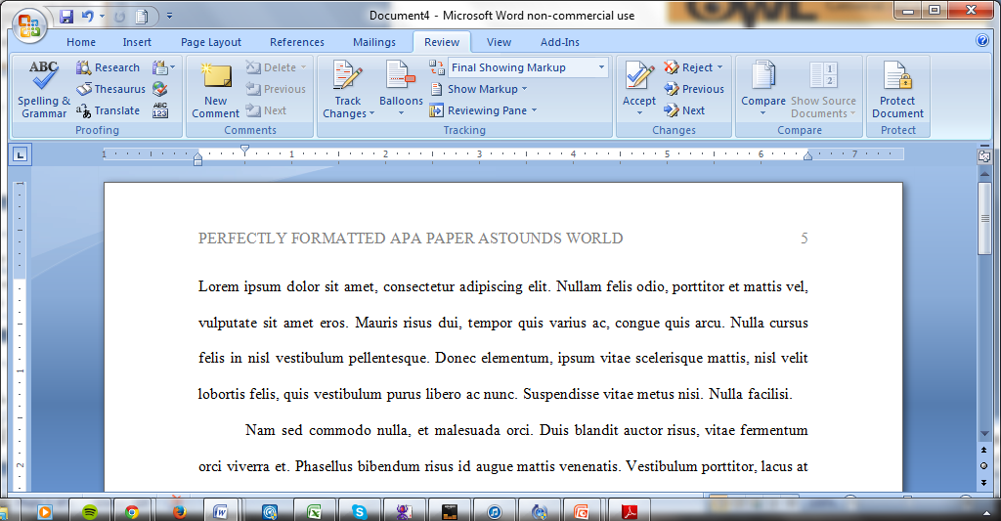
General APA Format
Every page of your essay should:
Include a page header (Title, all caps) in the upper left-hand corner and
the page number in the upper right
APA Formatting and Style Guide

Slide 10
General APA Format
References
Your essay should
include four major
sections:
Main Body
Abstract
Title page
APA Formatting and Style Guide

Slide 11
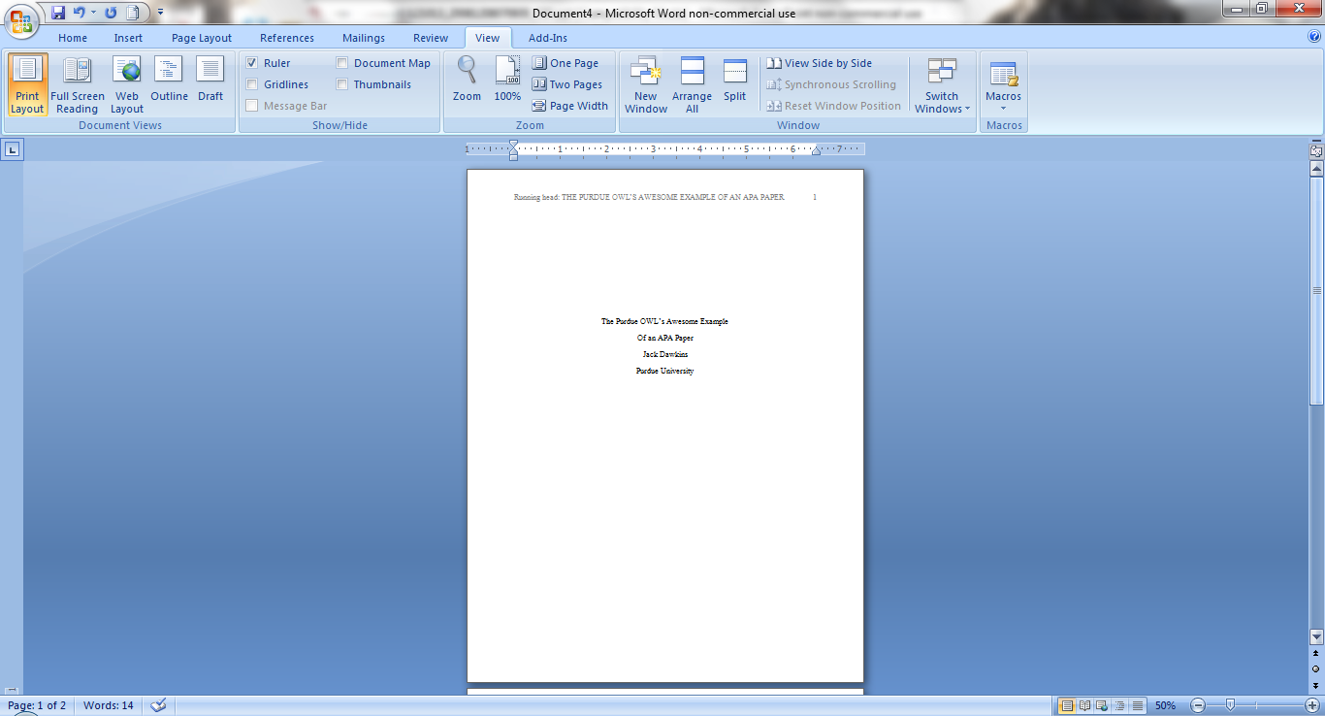
Title Page
Page header:
(use Insert Page Header)
title flush left + page number flush right.
Title:
(in the upper half of the page, centered)
name (no title or degree) + affiliation (university, etc.)
APA Formatting and Style Guide

Slide 12
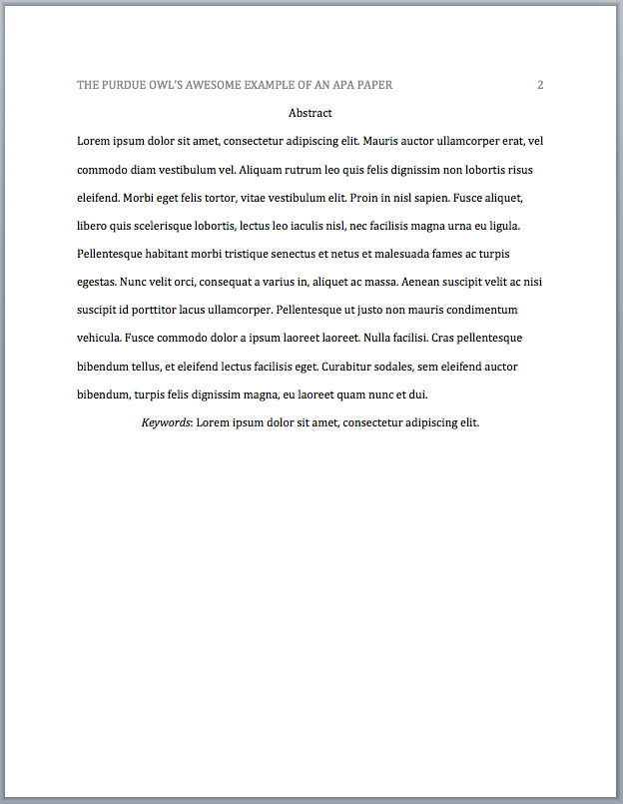
Abstract Page
Page header: do NOT include “Running head:”
Abstract: centered, at the top of the page
Write a 150- to 250- word summary of your paper in an accurate, concise, and specific manner.
APA Formatting and Style Guide

Slide 13
Main Body (Text)
Number the first text page as page number 3
Type and center the title of the paper at the top of the page
Type the text double-spaced with all sections following each other without a break
Identify the sources you use in the paper in parenthetical, in-text citations
Format tables and figures
APA Formatting and Style Guide

Slide 14
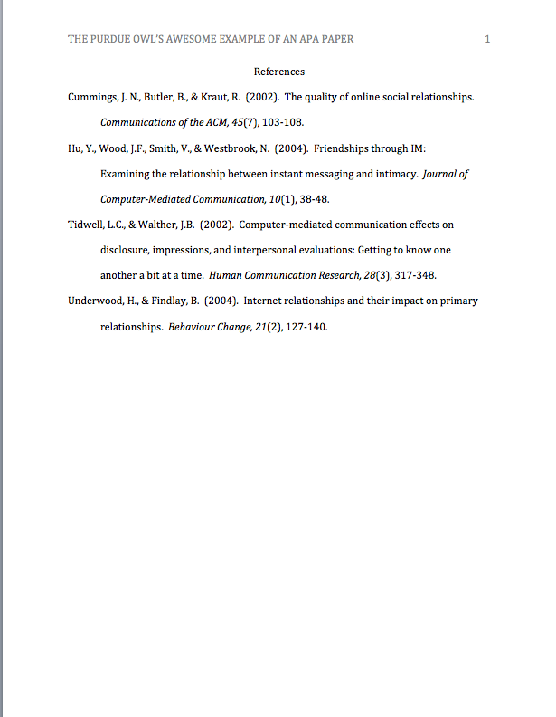
Reference Page
Center the title (References) at the top of the page. Do not bold it.
Double-space reference entries
Flush left the first line of the entry and indent subsequent lines
Order entries alphabetically by the surname of the first author of each work
APA Formatting and Style Guide

Slide 15
References: Basics
Invert authors’ names (last name first followed by initials)
EX:“Smith, J.Q.”
Capitalize only the first letter of the first word of a title and subtitle, the first word after a colon or a dash in the title, and proper nouns. Do not capitalize the first letter of the second word in a hyphenated compound word.
EX: The perfectly formatted paper: How the Purdue OWL saved my essay.
APA Formatting and Style Guide

Slide 16
References: Basics
Capitalize all major words in journal titles
Italicize titles of longer works such as books and journals
Do not italicize, underline, or put quotes around the titles of shorter works such as journal articles or essays in edited collections
APA Formatting and Style Guide

Slide 17
Making the Reference List
APA is a complex system of citation. When compiling the reference list, the strategy below might be useful:
Identify the type of source:
Is it a book? A journal article? A webpage?
Find a sample citation for this type of source
Check a textbook or the OWL APA Guide: http://owl.english.purdue.edu/owl/resource/560/01/
“Mirror” the sample
Make sure that the entries are listed in alphabetical order and that the subsequent lines are indented (Recall References: Basics)
APA Formatting and Style Guide

Slide 18
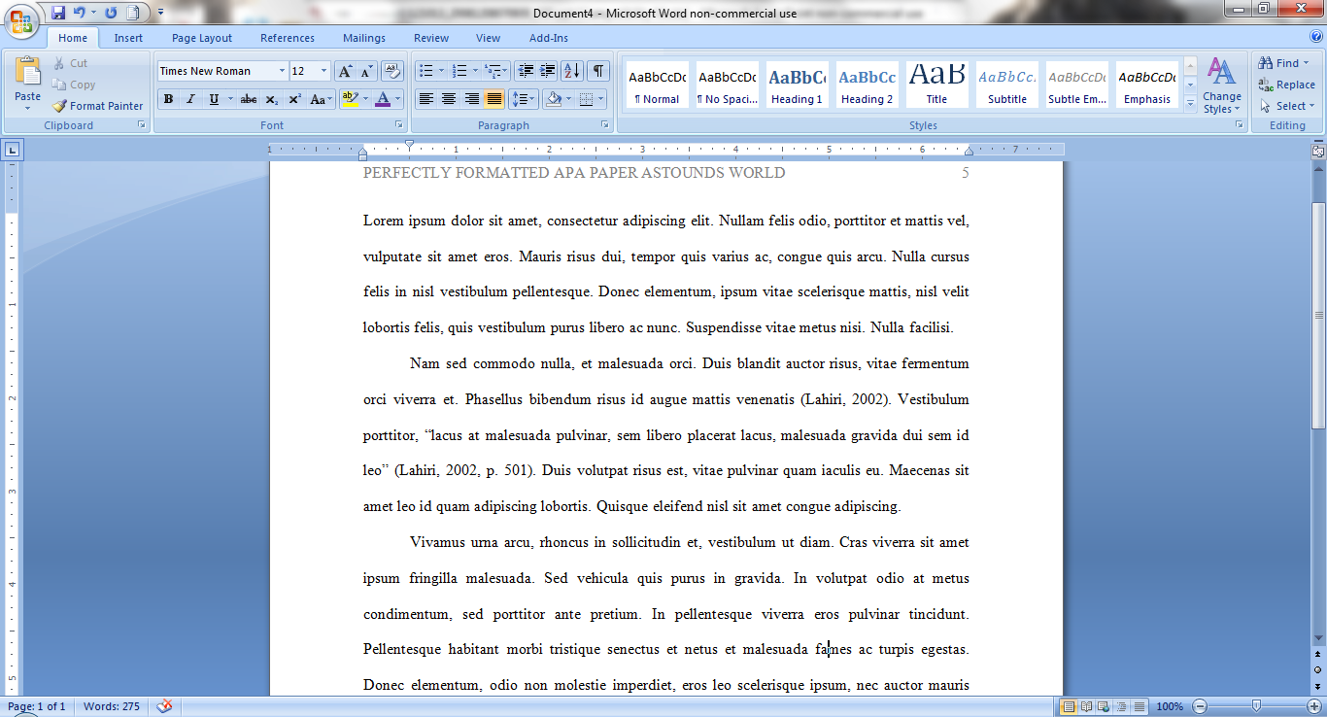
In-text Citation: Basics
In-text citations help readers locate the cited source in the References section of the paper.
Whenever you use a source, provide in parenthesis:
the author’s name and the date of publication
for quotations and close paraphrases, provide the author’s name, date of publication, and a page number
APA Formatting and Style Guide

Slide 19
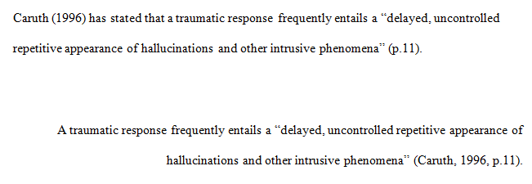
In-Text Citation: Quotations
When quoting:
Introduce the quotation with a signal phrase
Include the author’s name, year of publication, and page number
Keep the citation brief—do not repeat the information
APA Formatting and Style Guide

Slide 20
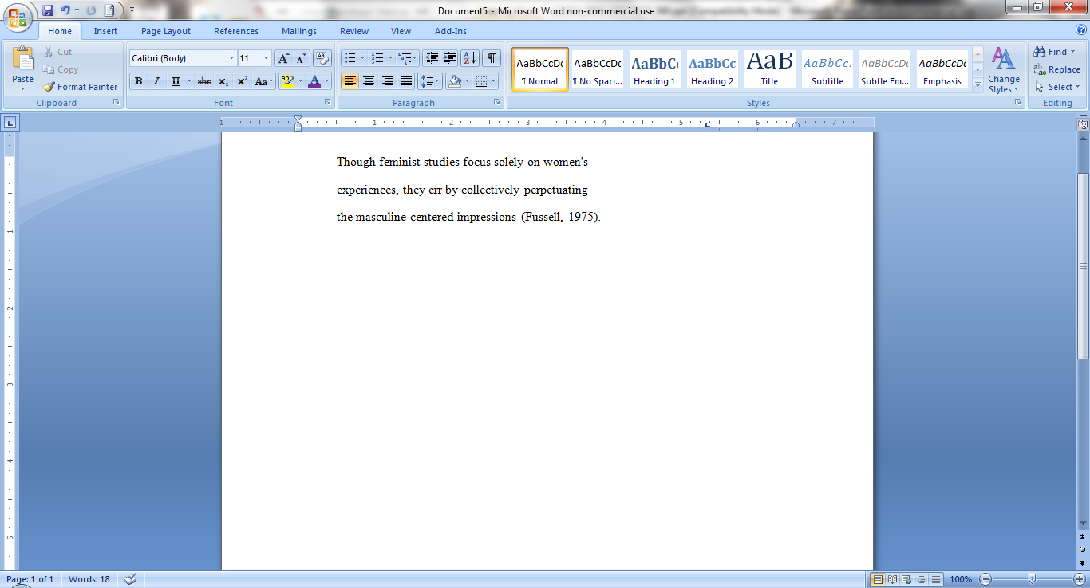
In-Text Citation: Summary or Paraphrase
Provide the author’s last name and the year of
publication in parenthesis after a summary or a paraphrase.
APA Formatting and Style Guide

Slide 21
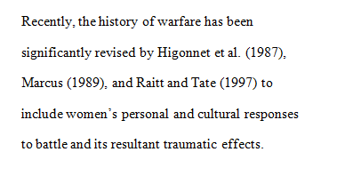
In-Text Citation: Summary or Paraphrase
Include the author’s name in the signal phrase, followed by the year of publication in parenthesis.
APA Formatting and Style Guide

Slide 22
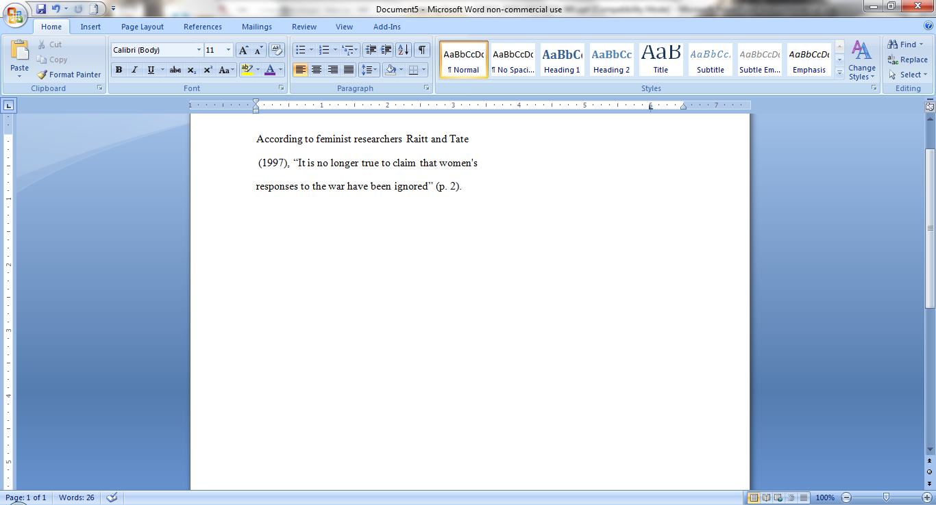
In-Text Citation: Summary or Paraphrase
When including the quotation in a summary/paraphrase, also provide a page number in parenthesis after the quotation:
APA Formatting and Style Guide

Slide 23
In-Text Citation: Signal Words
Introduce quotations with signal phrases, e.g.:
According to Xavier (2008), “….” (p. 3).
Xavier (2008) argued that “……” (p. 3).
Use such signal verbs such as:
acknowledged, contended, maintained,
responded, reported, argued, concluded, etc.
Use the past tense or the present perfect tense of verbs in signal phrases when they discuss past events.
APA Formatting and Style Guide

Slide 24
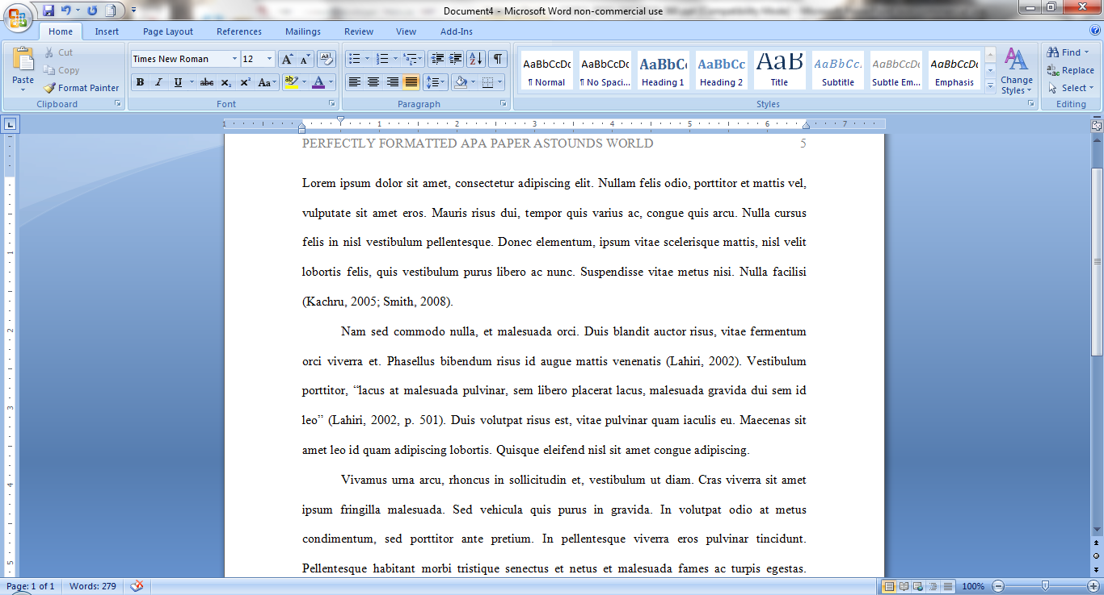
In-Text Citation: Two or More Works
When the parenthetical citation includes two or
more works, order them in the same way they appear in the reference list—the author’s name, the year of publication—separated by a semi-colon.
APA Formatting and Style Guide

Slide 25
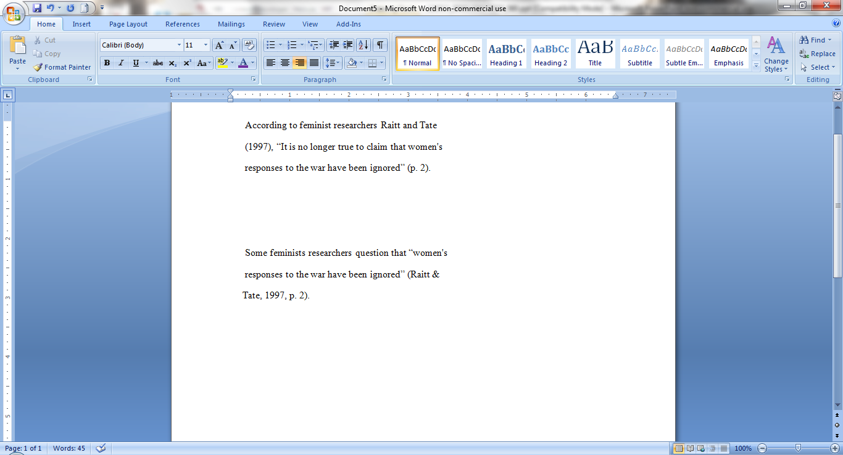
In-Text Citation: Works with Two Authors
When citing a work with two authors, use
In the signal phrase, use “and” in between the authors’ names
In parenthesis, use “&” between names
APA Formatting and Style Guide

Slide 26
In-Text Citation: Works with 3-5 Authors
When citing a work with three to five authors, identify all authors in the signal phrase or in parenthesis.
(Harklau, Siegal, & Losey, 1999)
In subsequent citations, only use the first author's last name followed by "et al." in the signal phrase or in parentheses.
(Harklau et al., 1993)
APA Formatting and Style Guide

Slide 27
In-Text Citation: Works with 6+ Authors
When citing a work with six and more authors, identify the first author’s name followed by “et al.”
Smith et al. (2006) maintained that….
(Smith et al., 2006)
APA Formatting and Style Guide

Slide 28
In-Text Citation: Unknown Author
When citing a work of unknown author:
use the source’s full title in the signal phrase
cite the first word of the title followed by the year of publication in parenthesis.
According to “Indiana Joins Federal Accountability System” (2008)
OR
(“Indiana,” 2008)
Titles:
Articles and Chapters = “ ”
Books and Reports = italicize
APA Formatting and Style Guide

Slide 29
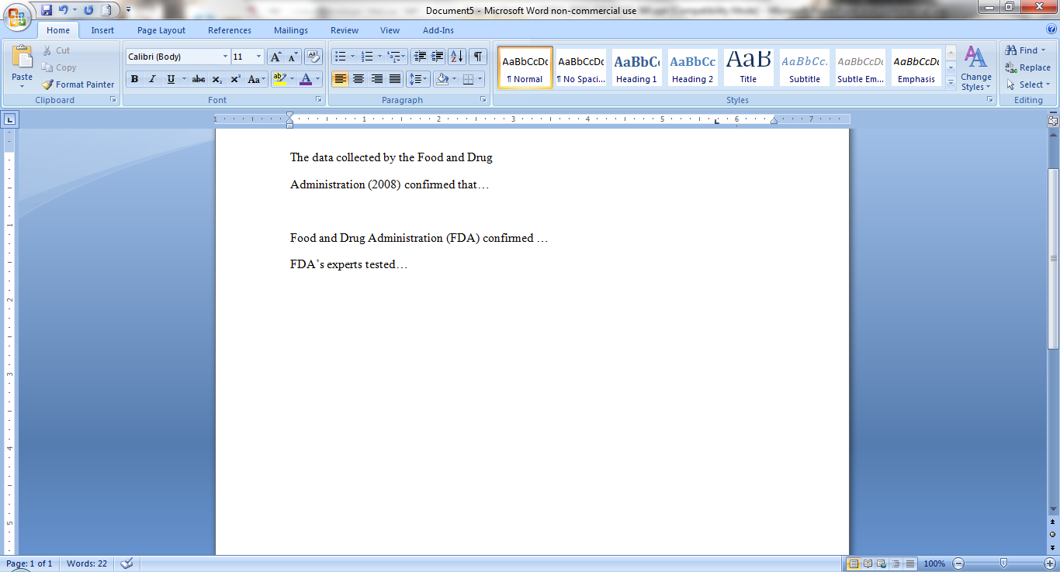
In-Text Citation: Organization
When citing an organization:
mention the organization the first time you cite the source in the signal phrase or the parenthetical citation.
If the organization has a well-known abbreviation, include the abbreviation in brackets the first time the source is cited and then use only the abbreviation in later citations.
APA Formatting and Style Guide

Slide 30
In-Text Citation: Same Last Name/Author
When citing authors with the same last names, use first initials with the last names.
(B. Kachru, 2005; Y. Kachru, 2008)
When citing two or more works by the same author and published in the same year, use lower-case letters (a, b, c) after the year of publication to order the references.
Smith’s (1998a) study of adolescent immigrants…
APA Formatting and Style Guide

Slide 31
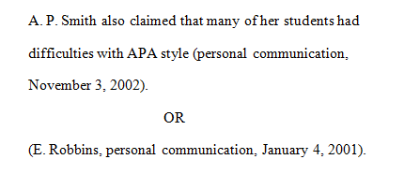
In-Text Citation:Personal Communication
When citing interviews, letters, e-mails, etc., include the communicator’s name, the fact that it was personal communication, and the date of the communication.
Do not include personal communication in the reference list.
APA Formatting and Style Guide

Slide 32
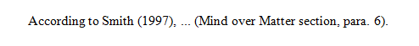
In-Text Citation: Electronic Sources
When citing an electronic document, whenever possible, cite it in the author-date style. If electronic source lacks page numbers, locate and identify paragraph number/paragraph heading.
APA Formatting and Style Guide

Slide 33
Headings
APA uses a system of five heading levels
APA Headings
Level | Format
1 | Centered, Boldfaced, Upper & Lowercase Headings
2 | Left-aligned, Boldface, Upper & Lowercase Headings
3 | Indented, boldface, lowercase heading with a period.
4 | Indented, boldface, italicized, lowercase heading with period.
5 | Indented, italicized, lowercase heading with a period.
APA Formatting and Style Guide

Slide 34
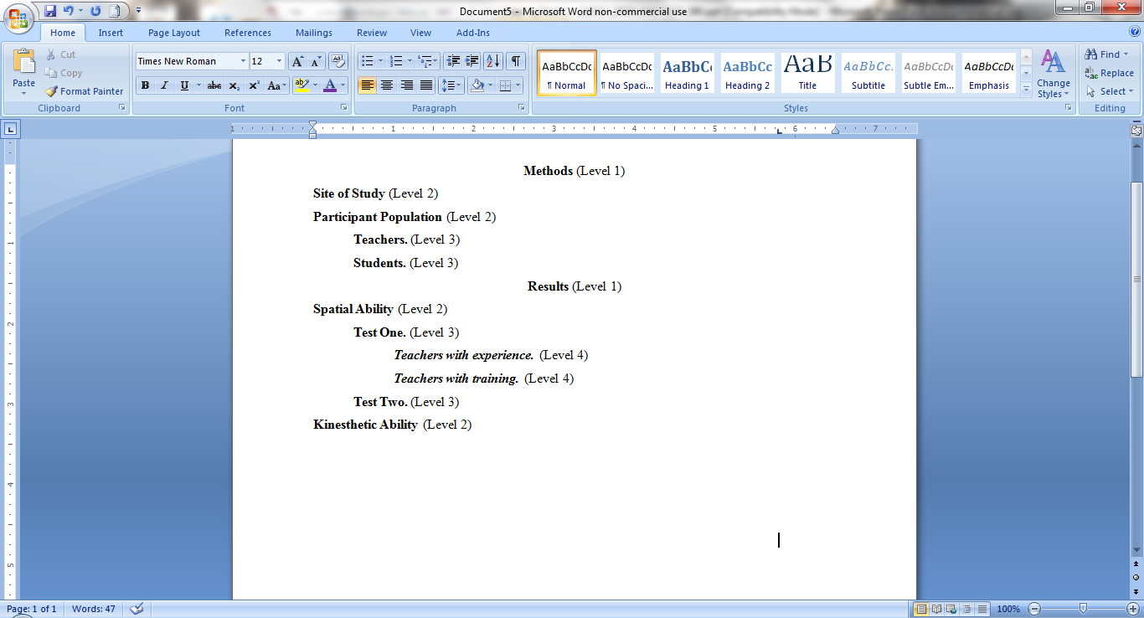
Headings
Here is an example of the five-level heading system:
APA Formatting and Style Guide

Slide 35
Tables
Label tables with an Arabic numeral and provide a title. The label and title appear on separate lines above the table, flush-left and single-spaced.
Cite a source in a note below the table.
Table 1
Internet users in Europe
Country | Regular Users
France | 9 ml
Note: The data are adapted from “The European Union and Russia” (2007). Retrieved from http://epp.eurostat.ec.europa.eu
APA Formatting and Style Guide

Slide 36
Figures
Label figures with an Arabic numeral and provide a title. The label and the title appear on the same line below the figure, flush-left .
You might provide an additional title centered above the figure.
Cite the source below the label and the title.
Figure 1. Internet users in Europe. Adapted from The European Union and Russia: Statistical comparison by Eurostat Statistical Books, 2007, Retrieved from http://epp.eurostat.ec.europa.eu
APA Formatting and Style Guide

Slide 37
Additional Resources
The Purdue OWL: http://owl.english.purdue.edu
The Purdue Writing Lab @ HEAV 226
Composition textbooks
Publication Manual of the American Psychological Association, 6th ed.
APA’s website: http://www.apastyle.org
APA Formatting and Style Guide

Slide 38
The End
APA Formatting and Style Guide
Brought to you in cooperation with the Purdue Online Writing Lab
APA Formatting and Style Guide

